Slide 1

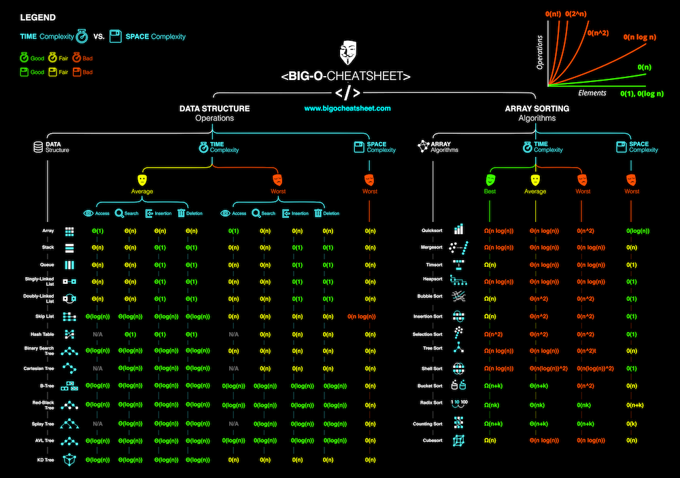
Analysis of Algorithms: Time and Space Complexity

Slide 2


topic layout
Motivation: Why should we learn this?
Asymptotic Analysis: The foundation for the analysis of algorithms
Applications of Asymptotic Analysis: Time and space complexity
Time Complexity Further
Space Complexity Further
The Interplay between time and space complexity
A look at some well-known algorithms
Analysis of these examples
Closing
Conclusion

Slide 3
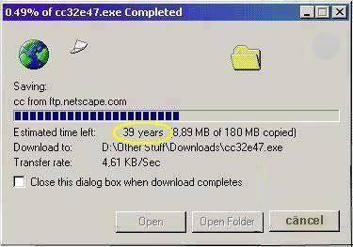
Motivation
A question that we should answer before continuing with this presentation is simple: Why should we bother learning about this?
As human beings, we have finite resources. Take food for example. We can’t make a cheeseburger appear from thin air: we need some way to produce that food using other resources.
Algorithms are no exception. For an algorithm to run, it needs a certain amount of time to finish depending on the type of task and the size of its input. In addition, an algorithm may need a certain amount of space in terms of memory to use in order to run as well.
Let’s look at an example: company A develops a new algorithm that will predict the weather for the next week. The drawback, however, is that it takes 20 years to run.
Now let’s say the company develops a faster algorithm for the same task, though it needs 5 Terabytes of memory to run.
The point is that for an algorithm to be useful to us, we need to develop it so that it utilizes resources adequately. If it doesn’t, its not viable to use.

Slide 4
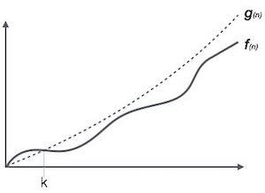
Asymptotic Analysis
In mathematics, asymptotic analysis, also known as asymptotics, is a method of describing ”limiting behavior”, or more specifically how a function f(n) behaves as it approaches some non-negative point n = n*,
In computer science, we apply asymptotic analysis to algorithms so that we can get a sense of their performances based upon different inputs
This enables us to explicitly compare the growth rates of different algorithms, giving us the ability to choose one algorithm over another based upon which does a ”better” job (with respect to our resources

Slide 5
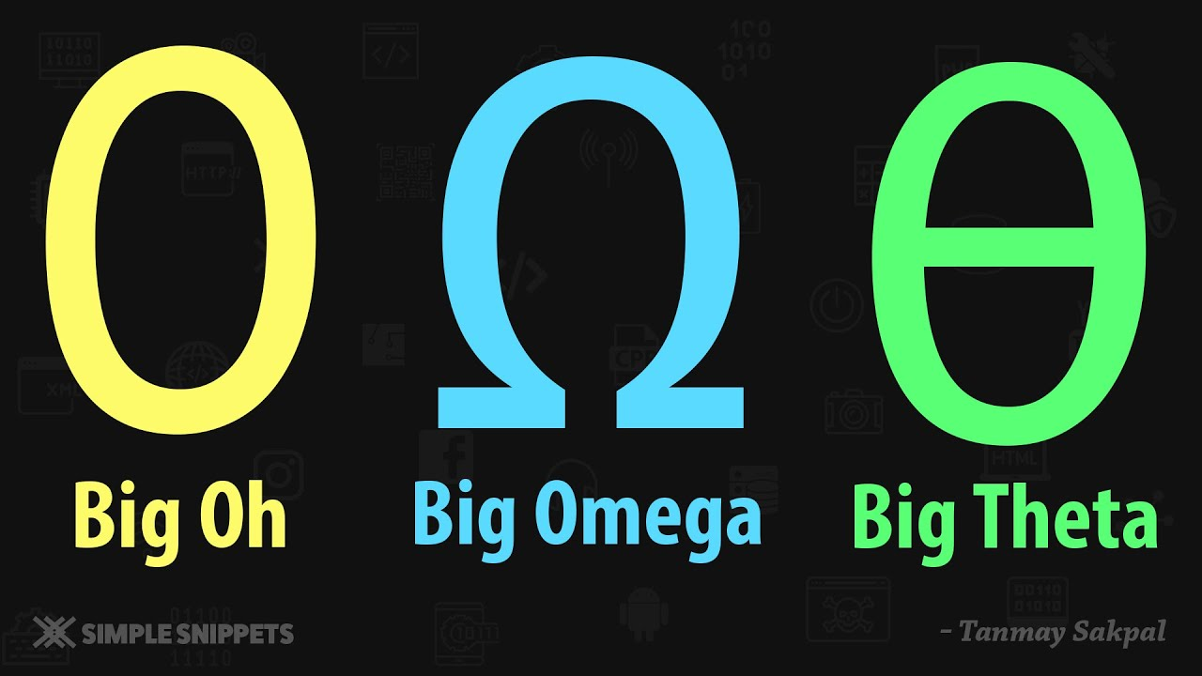

𝛰 (oh), 𝛺 (omega) and 𝛳 (theta)
When analyzing functions using asymptotic analysis, we classify their growth using the Greek symbols 𝛰,𝛺 and 𝛳
For example, take two functions f(n) and g(n):
$f\left(n\right)=Ο(g\left(n\right))$ means that g(n) is “big oh” of f(n)
$f\left(n\right)=Ω(g\left(n\right))$ means that g(n) is “big omega” of f(n)
$f\left(n\right)=Θ(g\left(n\right))$ means that g(n) is “big theta” of f(n), which also implies $g\left(n\right)=θ(f\left(n\right))$

Slide 6
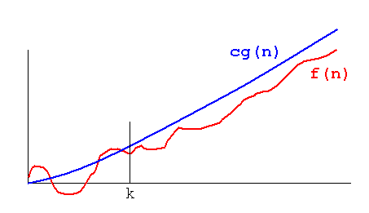

𝛰 (big ”oh”)
We say that a function $f\left(n\right)= Ο\left(g\left(n\right)\right)$ if for values $n≥n_{0}, 0≤f\left(n\right)≤C∗g(n)$ where C is some positive constant and $n_{0}$ is some initial value for n for which this expression is true
To break this down into simpler terms, what this means is that no matter what we take n to be, it will always be the case that C*g(n) will always be greater than f(n) for the specified value of n
Ex: Take f(n) = 5n and g(n) = n. In addition, let’s take our $n_{0}=1$ and our C = 10. We can see that for all values $n≥1$, $0≤5n≤10∗n$. Therefore, it is the case that $f\left(n\right)=Ο(g\left(n\right))$
To better understand, let’s graph this example

Slide 7
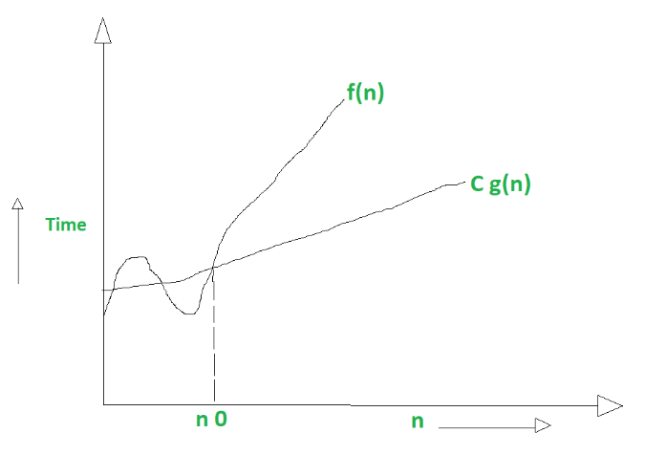

𝛺 (big ”omega”)
We say that a function $f\left(n\right)= Ω\left(g\left(n\right)\right)$ if for values $n≥n_{0}, 0≤C∗g(n)≤f(n)$ where C is some positive constant and $n_{0}$ is some initial value for n for which this expression is true
This means that f(n), regardless of what we multiply g(n) by, for all $n_{0}≥n$ f(n) will always be larger than C*g(n)
Ex: Take f(n) = $n^{2}$ and g(n) = n. Let’s take our $n_{0}=4$ and our C = 10. We can see that for all values $n≥4$, $0≤n^{2}≤10∗n$. Therefore, it is the case that $f\left(n\right)=Ω(g\left(n\right))$
To better understand, let’s graph this example

Slide 8
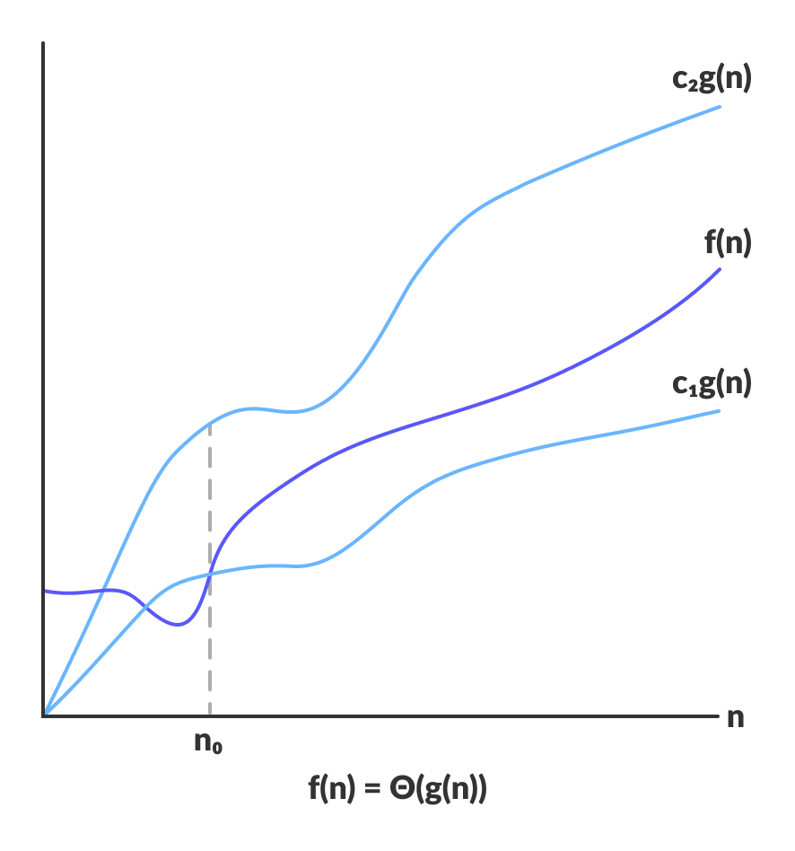

𝜃 (big ”theta”)
We say that a function $f\left(n\right)= θ(g\left(n\right))$ and $g\left(n\right)= θ(f\left(n\right))$ if for values $n≥n_{0}, 0≤C_{1}g\left(n\right)≤f\left(n\right)≤C_{2}g\left(n\right)$ where $C_{1}, C_{2}$ are positive constants such that $C1≤C_{2}$ and $n_{0}$ is some initial value for n for which this expression is true
This means that f(n), for all $n_{0}≥$ will always be bounded between $C_{1}g(n)$ and $C_{2}g\left(n\right)$ and vice versa
This also means that g(n) is bounded by these constants times f(n)
Furthermore, proving this is essentially just proving that both f(n) = 𝛰(g(n)) and f(n) = 𝛺(g(n))
For this question, let’s do a written example and graph afterwards...

Slide 9
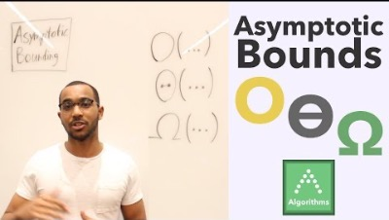
Let’s look at a video going deeper into these notations...

Slide 10
Applications of asymptotic analysis: time and space complexity
Now that we know what asymptotic analysis is, how do we apply them to algorithms?
This brings us to the topics of time complexity and space complexity, which allow us to measure the running time and space resources an algorithm needs to run with a given input
Time complexity allows us to measure and compare the time needed for certain algorithms to run, while space complexity allows us to measure and compare the space/memory needed in order for algorithms to run

Slide 11
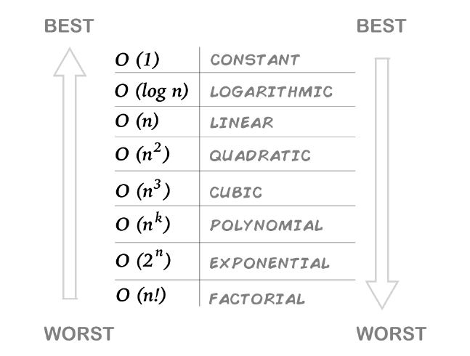
Time complexity
The definition of time complexity is ”the the computational complexity that describes the amount of computer time it takes to run an algorithm”
We have already developed a tool to analyze this computational complexity, however, that tool being asymptotic analysis
When analyzing time complexities for algorithms, we usually use 𝛺, 𝜃, 𝛰 to denote the best, average and worst running time of an algorithm
A list of some common big “oh” time complexities that algorithms are defined by

Slide 12

Space complexity
Space complexity is defined as “the amount of memory space required by an algorithm to solve an instance of a computational problem”
Like time complexity, space complexity can be analyzed using asymptotic analysis
like time complexity, 𝛺, 𝜃, 𝛰 denote the best, average and worst cases for an algorithm’s space complexity respectively
3D-printed versions of the Microsoft Word “Save” Icon (this was a joke no one picked up on ☹)

Slide 13
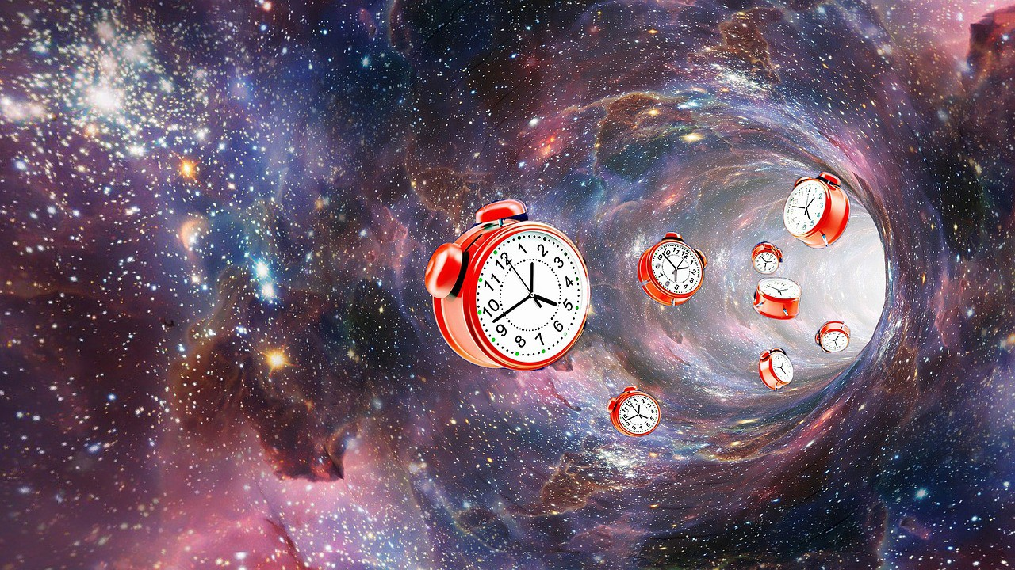
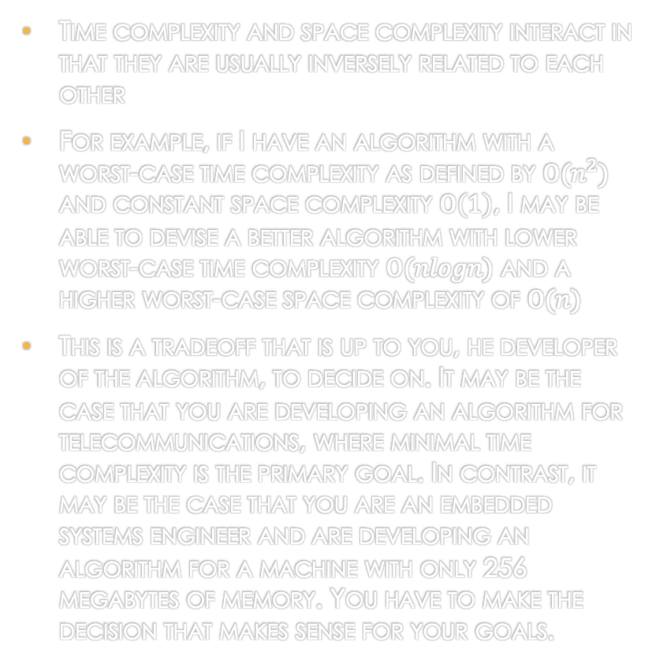
Time and space: how do they interact?
Time complexity and space complexity interact in that they are usually inversely related to each other
For example, if I have an algorithm with a worst-case time complexity as defined by $Ο(n^{2})$ and constant space complexity $Ο\left(1\right)$, I may be able to devise a better algorithm with lower worst-case time complexity $Ο(nlogn)$ and a higher worst-case space complexity of $Ο(n)$
This is a tradeoff that is up to you, he developer of the algorithm, to decide on. It may be the case that you are developing an algorithm for telecommunications, where minimal time complexity is the primary goal. In contrast, it may be the case that you are an embedded systems engineer and are developing an algorithm for a machine with only 256 megabytes of memory. You have to make the decision that makes sense for your goals.

Slide 14
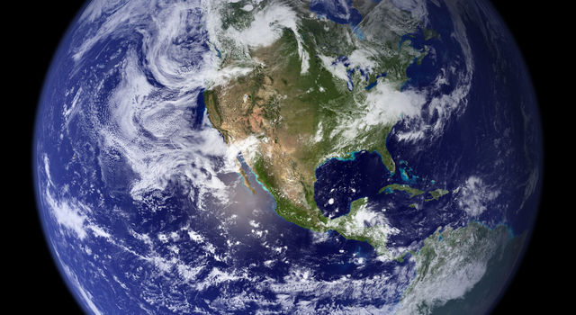
Closing remarks
From business, to education, to medicine, to communication, algorithms are used extensively in all aspects of modern life, with their viability being their most important trait
Therefore, it is imperative that the viability of these algorithms is constantly measured so that we can guarantee good performance, use the right algorithm for the right job and develop algorithms with better time and space complexities in the future

Slide 15
Conclusion and supplementary resources
THANK YOU FOR LISTENING!!!
SUPPLEMENTARY RESOURCES:
https://www.geeksforgeeks.org/analysis-of-algorithms-set-1-asymptotic-analysis/
https://www.tutorialspoint.com/data_structures_algorithms/asymptotic_analysis.htm
https://www.youtube.com/watch?v=0oDAlMwTrLo
https://www.youtube.com/watch?v=f_IaKCB7Zo8

